Slide 1
FISH270
Lecture 7

Slide 2
Reminders

Slide 3
Feeding in fishes

Slide 4
Fish
Fish are the largest phylum of living vertebrates, with around 34,000 fish species out of approximately 50,000 vertebrate species (www.fishbase.com, as of August 2015)
Fishes inhabit almost every aquatic environment on the planet, presenting an enormous variation in temperature, salinity, oxygen, and other chemical and physical water properties

Slide 5
Fish
Fishes (as well as other vertebrates), have an alimentary tract that comprises the same basic components: oral cavity (mouth), stomach, intestine and rectum, which serve to ingest and digest food, absorb nutrients, and eliminate undigested material

Slide 6
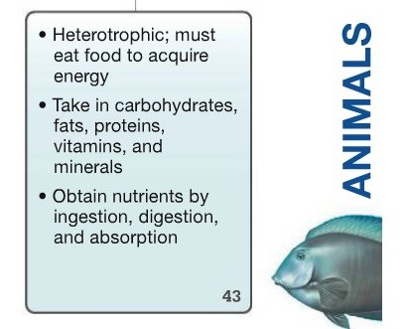
Fish
Fishes (as well as other vertebrates), have an alimentary tract that comprises the same basic components: oral cavity (mouth), stomach, intestine and rectum, which serve to ingest and digest food, absorb nutrients, and eliminate undigested material

Slide 7
Aspects vary
presence / absence stomach
length of __________
This is taken from “Fish Nutrition in Aquaculture” by S.S. de Silva, T.A. Anderson

Slide 8
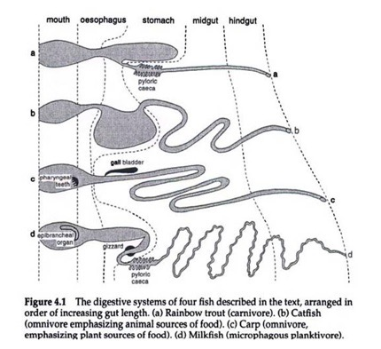
Aspects vary
presence / absence stomach
length of __________
This is taken from “Fish Nutrition in Aquaculture” by S.S. de Silva, T.A. Anderson

Slide 9
Sections
◦ Oral cavity (jaw, teeth, pharyngeal jaw and gill rakers)
◦ Stomach (gizzard and stomach)
◦ Pyloric caeca
◦ Intestine (intestine and spiral valve)
◦ Rectum

Slide 10
“Jaw” - Jawless fish
▪ Cyclostomes (“round mouth”, or agnathans): hagfish and lampreys
▪ Do not have jaw, they are the only jawless vertebrates
▪ Most primitive group of fishes
▪ Their mouths cannot close due to the lack of a jaw, so they have to constantly cycle water through the mouth

Slide 11
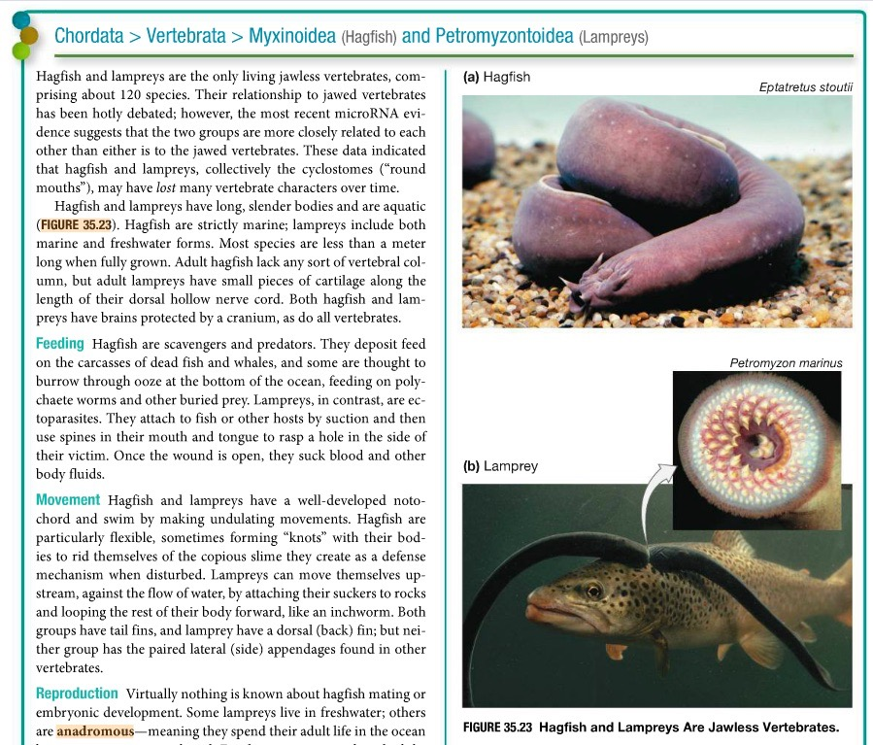

Slide 12
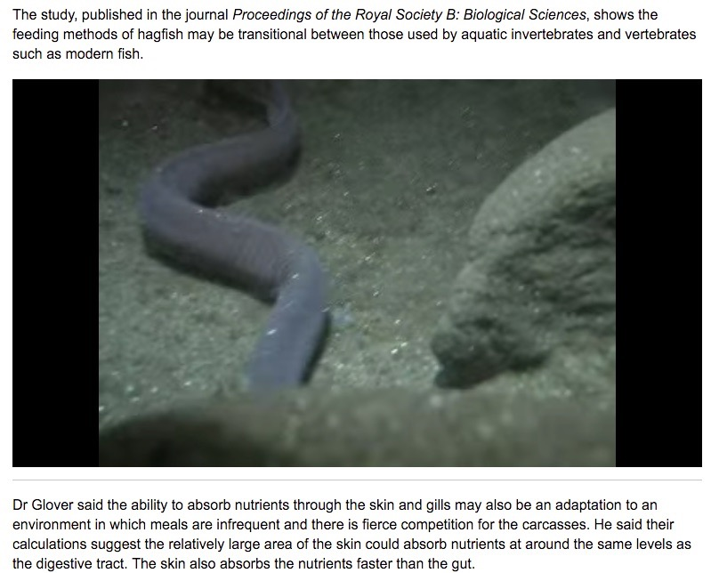
http://phys.org/news/2011-03-hagfish-skin.html

Slide 13
Jawed fish
▪ Gnathostomes: chondrichthyes (cartilaginous fishes) and osteichthyes (bony fishes)
▪ The evolution of jaws allowed gnathostomes to become effective predators and accounted for much of their subsequent success
▪ Gill-arch hypothesis: mutation and natural selection increased the size of the most anterior arch and modified its orientation, producing the first working jaw

Slide 14
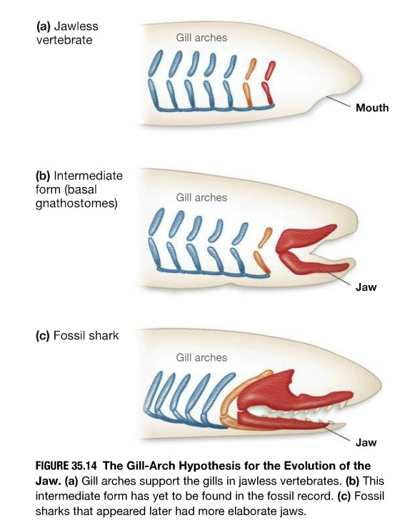

Slide 15
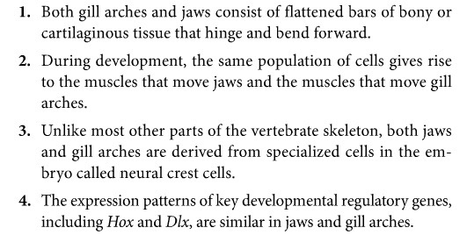

Slide 16
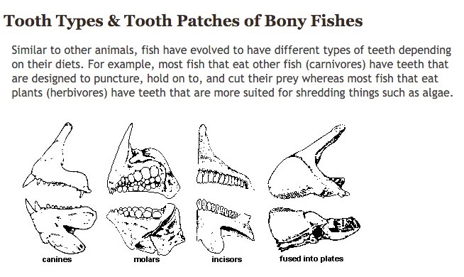
Teeth
http://www.flmnh.ufl.edu/fish/discover/fish/anatomy/tooth-types-patches

Slide 17
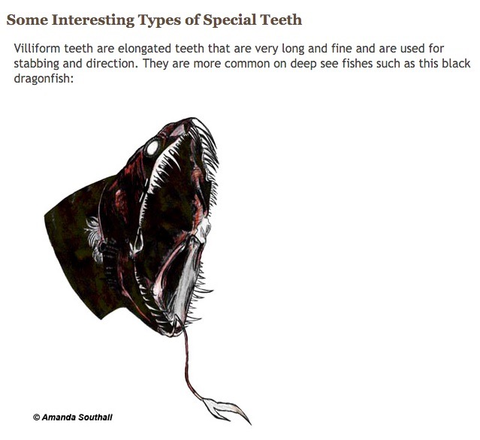
www.flmnh.ufl.edu/fish/discover/fish/anatomy/tooth-types-patches

Slide 18
Fun facts
▪ Most of sharks and rays, as well as other predator fishes, have polyphyodont teeth- teeth are continually replaced as they wear out or are lost. When a tooth or some teeth need to be replaced the gum moves forward pulling the new teeth both forward and erect.
▪ In other predator fishes the new teeth grow either at the base of the old teeth, or in between the old teeth when these teeth are not too closely packed.

Slide 19
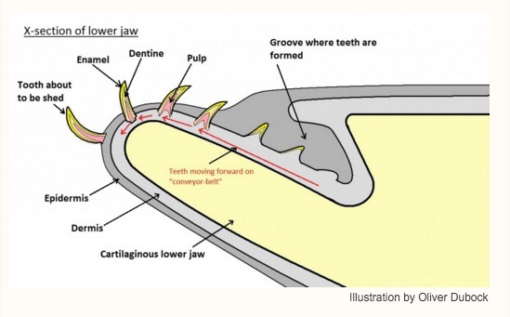
Fun facts
▪ Most of sharks and rays, as well as other predator fishes, have polyphyodont teeth- teeth are continually replaced as they wear out or are lost. When a tooth or some teeth need to be replaced the gum moves forward pulling the new teeth both forward and erect.
▪ In other predator fishes the new teeth grow either at the base of the old teeth, or in between the old teeth when these teeth are not too closely packed.

Slide 20
Pharyngeal Jaw
?????

Slide 21
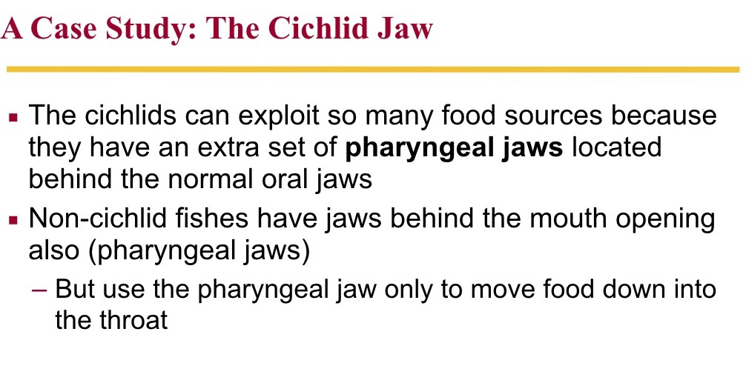
Pharyngeal Jaw

Slide 22
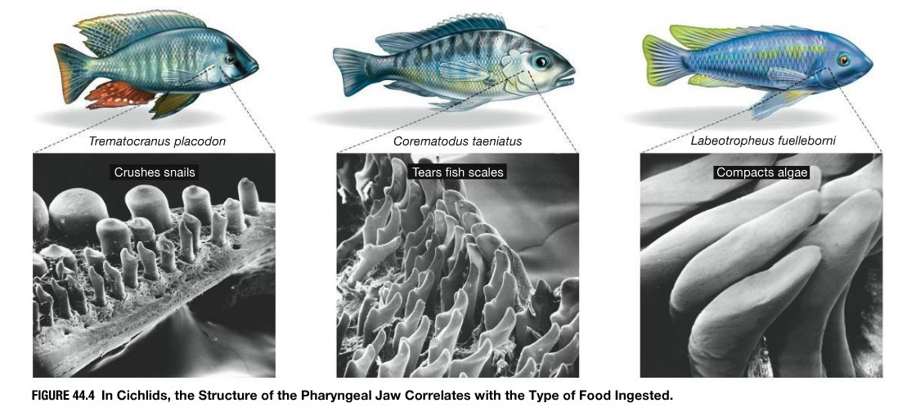
Pharyngeal Jaw

Slide 23
Gill Rakers
◦ Bony or cartilaginous processes that project from the branchial arch (gill arch) and are involved with suspension feeding tiny prey
◦ The structure and spacing of gill rakers in fish determines the size of food particles trapped, and correlates with feeding behavior
◦ Fish with densely spaced, elongated, comb-like gill rakers are efficient at filtering tiny prey, whereas carnivores and omnivores often have more widely spaced gill rakers with secondary projections

Slide 24
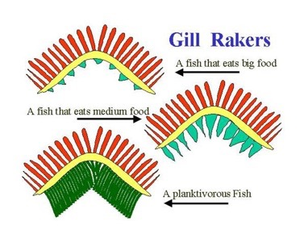
Gill Rakers
◦ Bony or cartilaginous processes that project from the branchial arch (gill arch) and are involved with suspension feeding tiny prey
◦ The structure and spacing of gill rakers in fish determines the size of food particles trapped, and correlates with feeding behavior
◦ Fish with densely spaced, elongated, comb-like gill rakers are efficient at filtering tiny prey, whereas carnivores and omnivores often have more widely spaced gill rakers with secondary projections

Slide 25
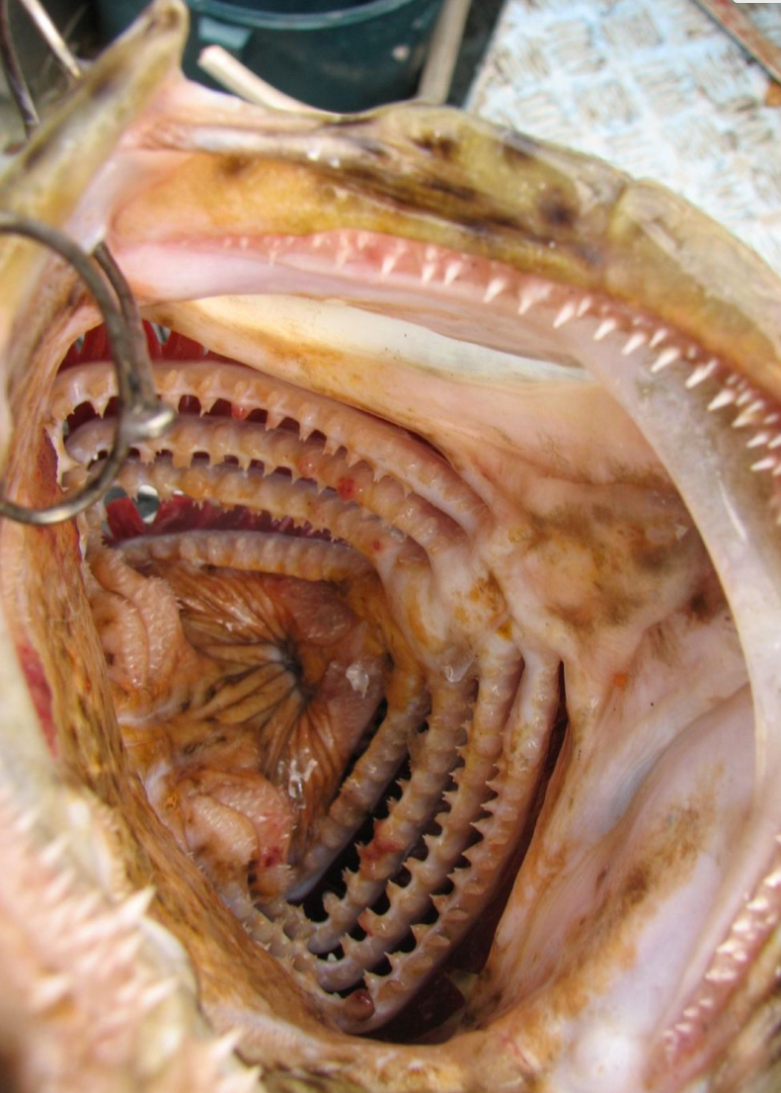

Slide 26
Gizzard
????

Slide 27
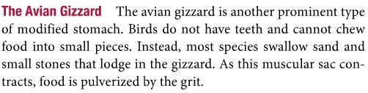
Gizzard
• The gizzard is a highly muscular modification of the first part of the stomach. It grinds up coarse food items into smaller pieces thus facilitating their later digestion
• In those fish which have a gizzard (e.g., mullet or shad) it is the place where digestion begins because as well as its muscular activity the gizzard also secretes digestive enzymes into the food.

Slide 28
Stomach

Slide 29
Stomach

Slide 30
No Stomach
◦ Approximately a quarter of fishes do not have stomach.
◦ This loss does not appear to impose dietary constraints. Stomach-less fishes cover the entire trophic spectrum.

Slide 31
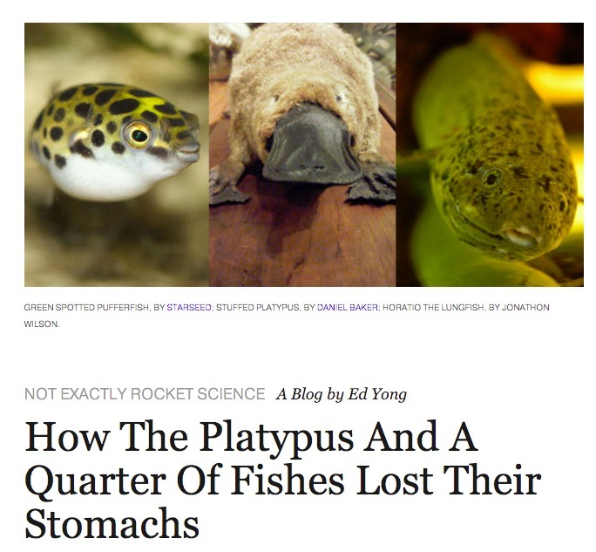

Slide 32
Stomachs!

Slide 33
Stomachs!
◦ A muscular bag, or tube with a highly acidic internal environment.
◦ All pure predators have stomach: Large stomach in carnivorous, and small stomach in herbivorous and omnivorous: digestion of proteins

Slide 34
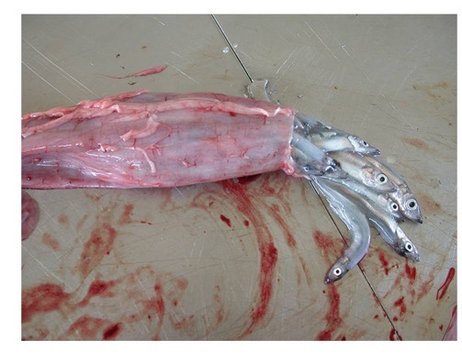
Atlantic salmon stomach sampled at West Greenland. This fish was feeding exclusively on capelin, an energy rich abundant prey, which serves as the primary food source for salmon in Greenland. Credit: Denise Deschamps, Ministère des Ressources naturelles et de la Faune du Québec-From NOAA

Slide 35
Pepsins
Pepsinogen (zymogen) and pepsin
Need of an acidic environment in the stomach
In fishes gastric acid (composed by HCl) and pepsinogen are secreted from the so-called oxynticopeptic cells
In most fish the pH of the stomach varies between 2 and 4.
Curiosity about versatility of stomachs- The black swallower feeds on bony fishes, which are swallowed whole. With its greatly distensible stomach, it is capable of swallowing prey over twice its length and 10 times its mass

Slide 36
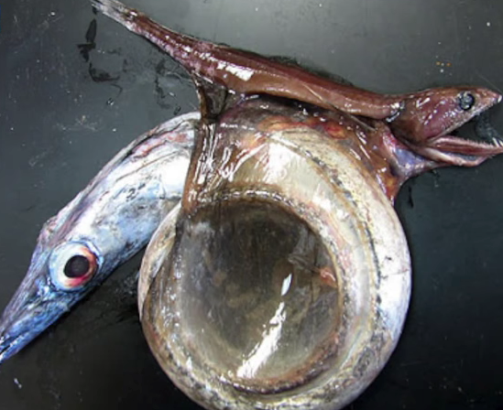
Pepsins
Pepsinogen (zymogen) and pepsin
Need of an acidic environment in the stomach
In fishes gastric acid (composed by HCl) and pepsinogen are secreted from the so-called oxynticopeptic cells
In most fish the pH of the stomach varies between 2 and 4.
Curiosity about versatility of stomachs- The black swallower feeds on bony fishes, which are swallowed whole. With its greatly distensible stomach, it is capable of swallowing prey over twice its length and 10 times its mass

Slide 37
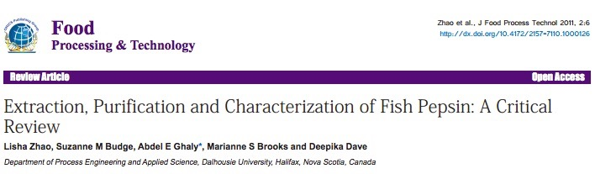
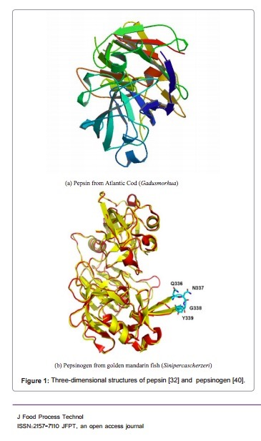
Pepsin is important aspartic proteases with many
unique characteristics. It has several industrial applications including collagen extraction, cheese making, fish processing as well as use in medical research.
Fish pepsin is primarily present in fish stomach and has
a characteristic pH optimum of 2.0 - 4.0, distinct pH stability ≤ 6.0, a distinct optimum temperature of 30-55ºC.

Slide 38
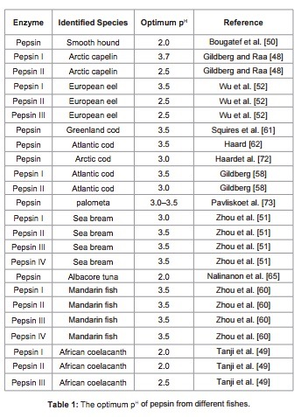

Slide 39
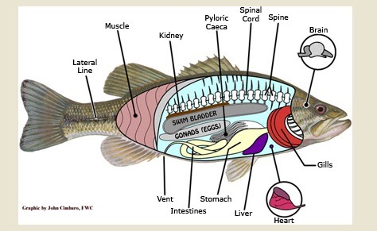
Pyloric caeca?

Slide 40
Pyloric caeca
◦ Organ with fingerlike projections is located near the junction of the stomach and the intestines
◦ It secretes trypsin and enzymes active in the intestines, it is also considered likely that they are important in neutralizing the acidity of the chyme (i.e., mixture of gastric juices, digesta and mucus) before it reaches the intestines, where the environment is alkaline in contrast to the stomachs acidity.

Slide 41
Intestine
◦ The intestine is a long thin tube with a thin double layer musculature, the outer layer being longitudinal and the inner layer being circular.
◦ Intestines become longer as the diet moves through being carnivorous to omnivorous to detritivorous to herbivorous.
▪ Carnivorous, have fairly short intestines because such food is easy to chemically break down and digest.
▪ Herbivorous, require longer intestines because plant matter is usually tough and fibrous and more difficult to break down into usable components.

Slide 42
Intestine

Slide 43
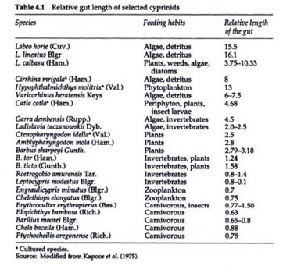
Intestine

Slide 44
Intestine
Chyme entering the small intestine stimulates secretions from the pancreas and gallbladder (bile)
Pancreatic secretions include bicarbonates (e.g., HCO3- ) which buffer acidity of the chyme
When bile (gallbladder) enters in the intestine, it raises the pH and emulsifies fat. Once fats are broken into small globules, which increase their surface area, they can be attacked by pancreatic lipases and digested.
Suite of enzymes in the intestinal environment

Slide 45
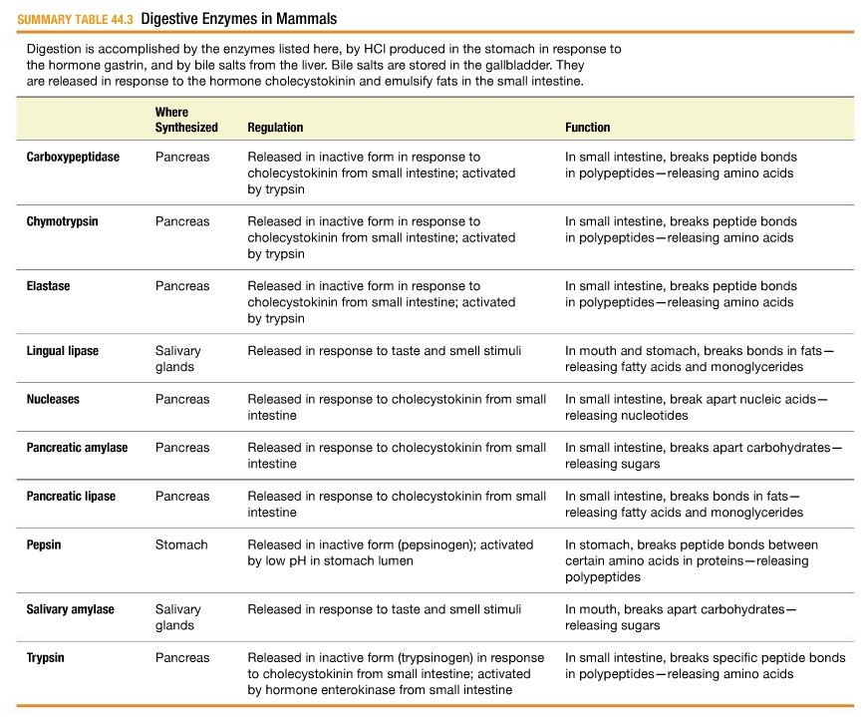

Slide 46
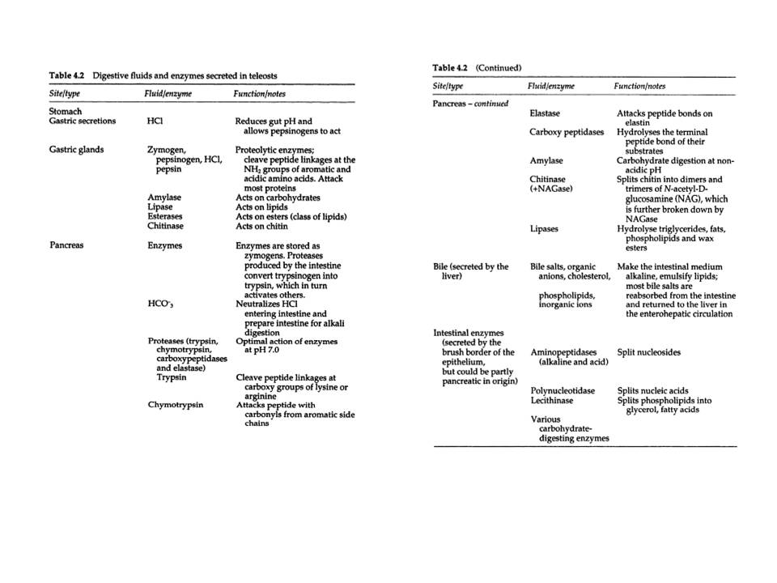

Slide 47
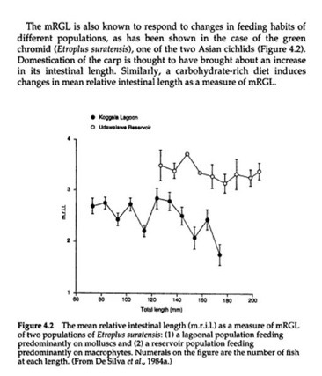
Gut Length

Slide 48
Intestine
- Most nutrient absorption occurs in the intestine
- Cross-section of the intestinal luma shows that it is highly convoluted, increasing surface area
- Absorption through membrane is either by:
- Passive transport (concentration gradient, e.g., electrolytes, monosaccharides, some vitamins, smaller amino acids)
- Active transport (requires ATP)
- Carbohydrates are absorbed as monosaccharides
- All nutrients, excluding some lipids, are absorbed from the intestine via the hepatic portal vein to the liver

Slide 49
Spiral Valve
◦ Corkscrew like structure that runs down the centre of the intestine
◦ Found in sharks, rays and in a few other ancient fish
◦ It allows a greater surface area for digestion and increased nutrient absorption
◦ Because the sharks absorb so much from their food they feed less frequently

Slide 50
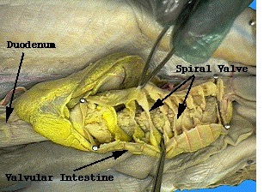
Spiral Valve
◦ Corkscrew like structure that runs down the centre of the intestine
◦ Found in sharks, rays and in a few other ancient fish
◦ It allows a greater surface area for digestion and increased nutrient absorption
◦ Because the sharks absorb so much from their food they feed less frequently

Slide 51
Rectum
◦ The rectum is the end of the intestines and through it feces pass out of the fish’s body and into the surrounding water
◦ In bony fish the rectum reaches the outside environment through the anus, which is normally situated just in front the urinary and reproductive openings.
◦ In the lungfish, sharks and rays the rectum opens into the cloaca which also receives wastes (urine) from the kidneys and material from the reproductive organs

Slide 52
Longer intestine?

Slide 53
What about shellfish?

Slide 54
What about shellfish?
Bivalves

Slide 55
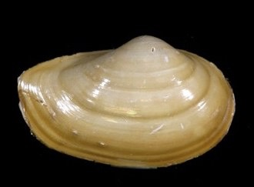
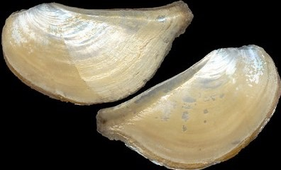
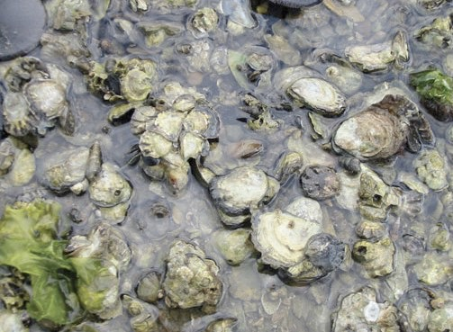
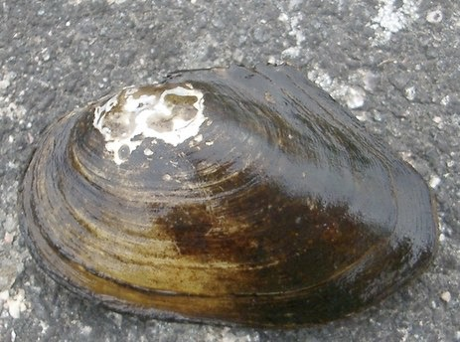
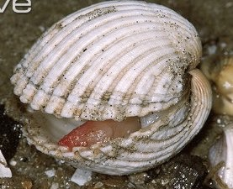
Taxonomy
Protobranchia
Anomalodesmata
Pteriomorphia
Paleoheterodonta
Heterodonta
Lamellibranchia
Notes:
Lamellibranchia based on gill morphology, recent taxonomy based on hinge
Pteriomorphia: Mytilus
Paleoheterodonta: FW mussels
Heterodonta: geoduck, Panopea

Slide 56
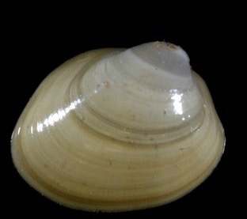
Subclass Protobranchia
Defining Characteristics
Small gills function just for gas exchange
Collect food with palp proboscides
Primitive physiology - ancestral
100% marine
Found in soft substrates
Found in deep waters (>1000m)
Example genus: Yoldia
Notes:
Ctenidia: unfolded, bipectinate, suspended in mantle cavity
Palp proboscides = long thin muscular extensions near mouth

Slide 57
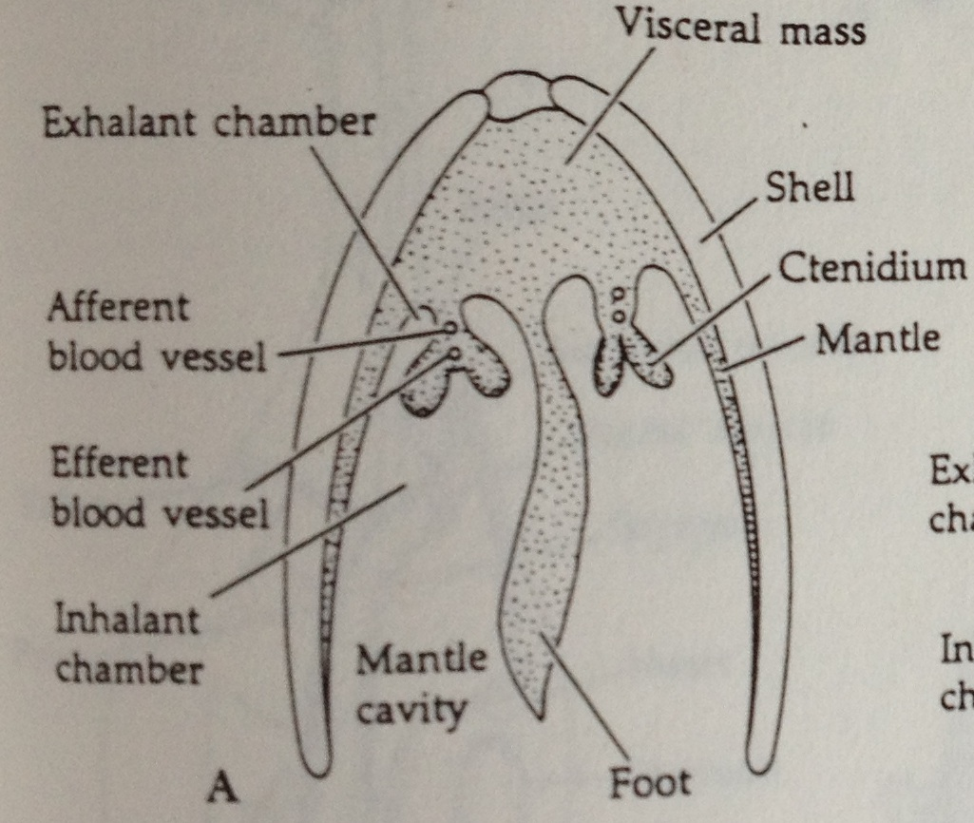
Protobranchia Gills
One pair of gills, flank body
Each gill has 2 parts: demibranchs
Bipectinate – 2 demibranchs extend from opposite sides of central gill axis
Gill filaments divide mantle cavity into in- and excurrent chambers
Ciliated filament edges move water & clean gills
Notes:
Most simple gills of all bivalves
Bipectinate: having lamellae on both sides of ctenidial axis

Slide 58
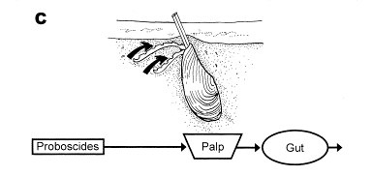
Protobranchia Feeding
Selective deposit feeders (primitive)
Traps particles in mucus on palp proboscide
Particles travel along ventral proboscide cilia to labial palp
Ciliated ridges of labial palp sort particles
Nutritious are ingested
Non-nutritious and toxic are expelled = pseudofeces
Ward & Shumway 2004
Notes:
Scaphopodia also deposit feed

Slide 59
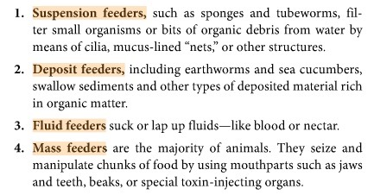
Protobranchia Feeding
Selective deposit feeders (primitive)
Traps particles in mucus on palp proboscide
Particles travel along ventral proboscide cilia to labial palp
Ciliated ridges of labial palp sort particles
Nutritious are ingested
Non-nutritious and toxic are expelled = pseudofeces
Ward & Shumway 2004
Notes:
Scaphopodia also deposit feed

Slide 60
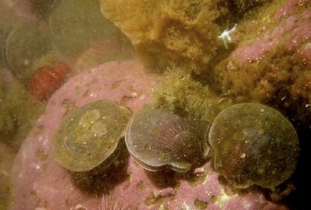
Lamellibranchia
Defining Characteristics
Gills function in gas exchange and food acquisition
Byssal thread production
Mostly marine; includes all freshwater bivalves
Dominate animal biomass in habitat
Applications: food, jewelry, biomonitoring
Invasive species
Incurrent & excurrent siphons
Notes:
Important ecological roles in marine & freshwater
What makes a species invasive? What are some lamellibranch invasives? Zebra mussels, pacific oyster

Slide 61
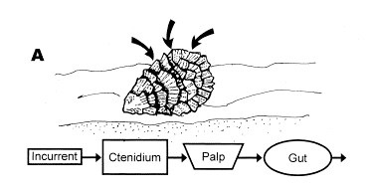
Lamellibranchia Gills
In- and excurrent siphons
Tubular extensions of the mantle
High rate of water processing + high density = ecological impact
Gills modified for food acquisition
Large ctenidium
Ciliated central groove of ctenidium
Increased # filaments
Lengthen & folded gill
Ward & Shumway 2004
Notes:
Water movement occurs posteriorly via siphons; single current for gas exchange & feeding
Large ctenidium: increase SA for particle collection, sorting & transport; large filaments fold on themselves so each row has 2 lamellae
Small palps

Slide 62
Lamellibranchia Gills
In- and excurrent siphons
Tubular extensions of the mantle
High rate of water processing + high density = ecological impact
Gills modified for food acquisition
Large ctenidium
Ciliated central groove of ctenidium
Increased # filaments
Lengthen & folded gill
Ward & Shumway 2004
Notes:
Water movement occurs posteriorly via siphons; single current for gas exchange & feeding
Large ctenidium: increase SA for particle collection, sorting & transport; large filaments fold on themselves so each row has 2 lamellae
Small palps

Slide 63
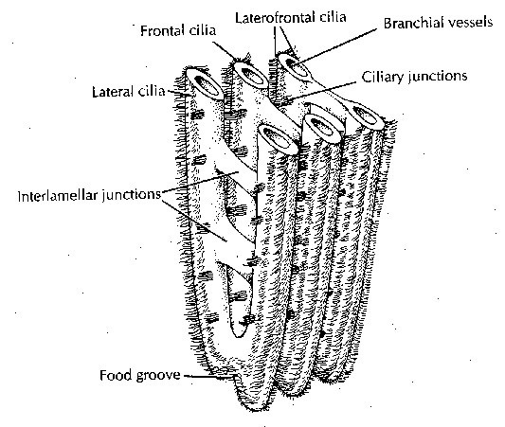
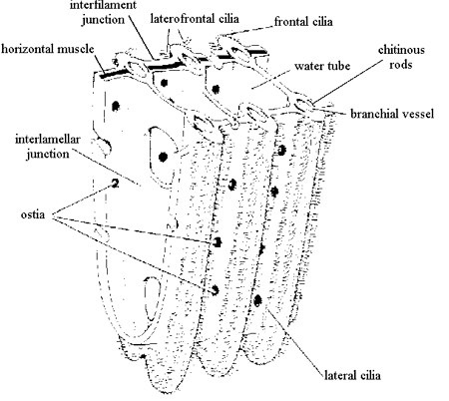
Lamellibranch Gills
Filibranch vs. Eulamellibranch
Filibranchs: filaments attached via ciliary tufts; often have byssal threads or cement
Eulamellibranchs: filaments attached via tissue bridges; inhalant & exhalant siphons; buried in sediment
Classifications were based on gill structure, are now based on hinge structure
Filibranch
Eulamellibranch
Notes:
Remember differences from lab? Examples of each?
Filibranchs: mussle, scallops
Eulamellibranchs: clams

Slide 64
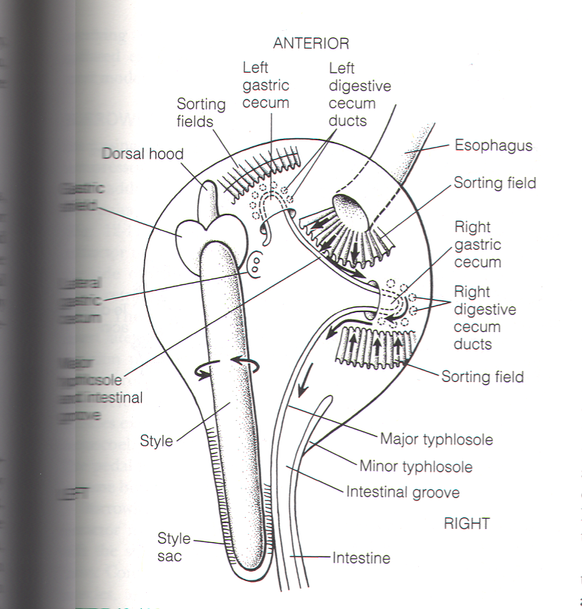
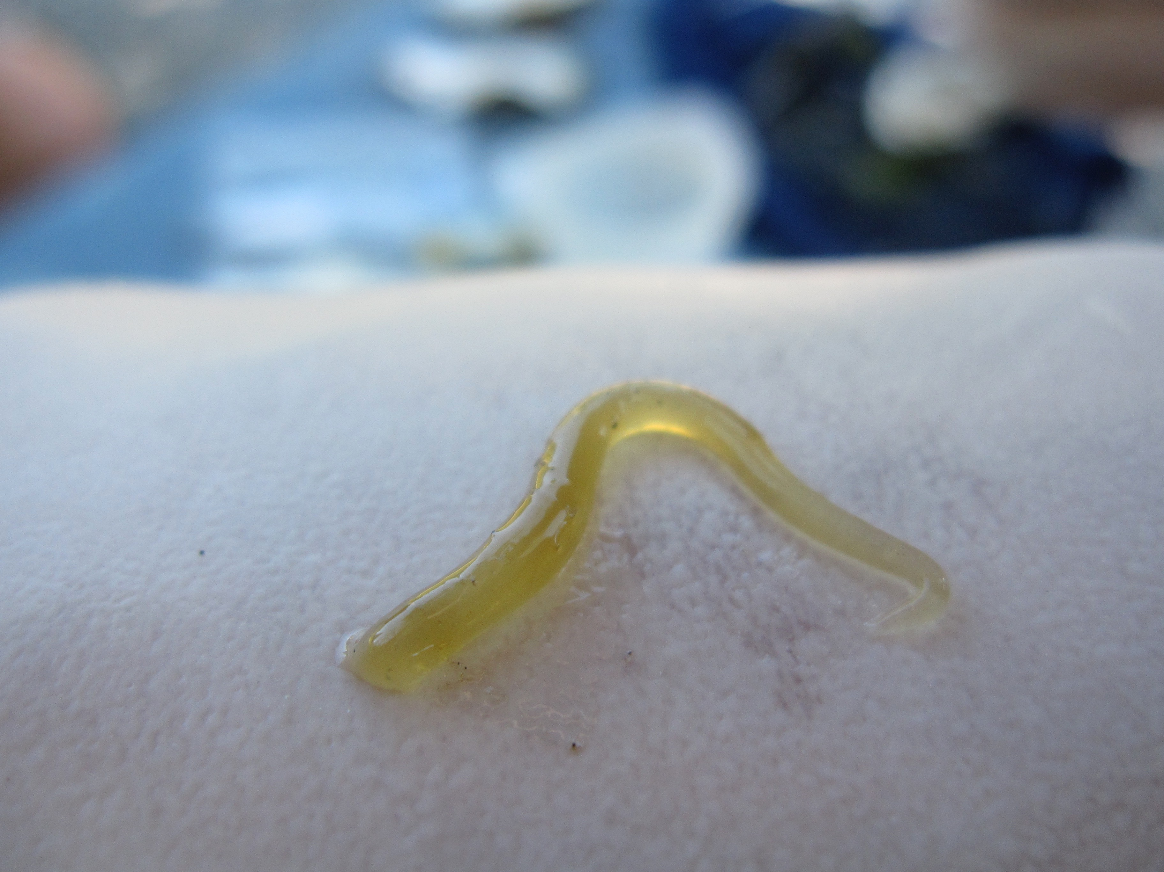
Lamellibranch Digestion
Particles concentrated at labial palps & delivered to stomach
Stomach digestion = crystalline style
Protein & digestive enzymes
Style sac cilia
Gastric shield degrades style
Particle sorting in stomach
Delivery to digestive glands
Dorsal
Gastric shield
Lateral gastric
cecum
Major typhlosole and intestinal groove
Notes:
Amylase in esophagus
Style sac is intestinal pouch
Degradation against gastric shield releases digestive enzymes
If symbionts, lesser digestive system (or nonexistent)

Slide 65
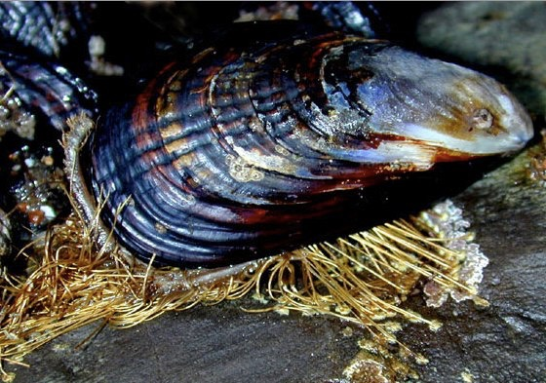
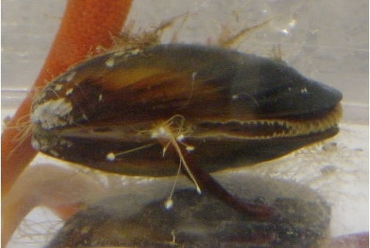
Lamellibranch Byssus
Byssal threads
Proteinaceous liquid
Transported to substrate via foot groove
Hardens in salt water (thin & sturdy threads)
Oysters permanently cement one shell valve
Life stage-dependent in some
Notes:
Attached bivalves have lost mantle fusion & siphon

Slide 66
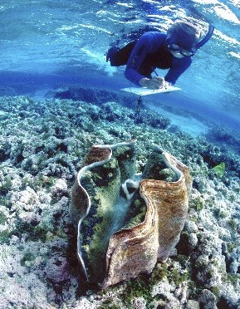
Byssus: Life Stage-Dependent
Use byssal threads as juveniles
Lose threads when heavy enough to resist currents
Notes:
Tridacna

Slide 67
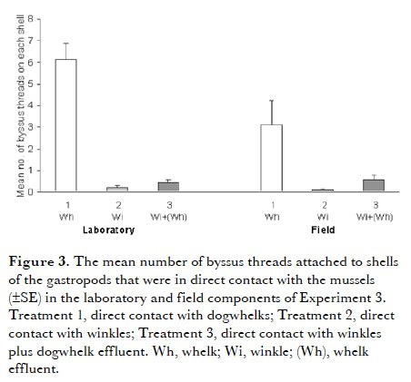
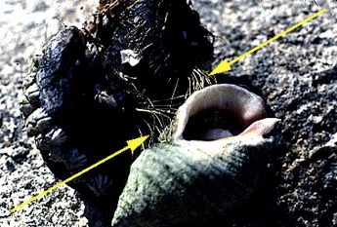
Byssus: Defense Mechanism
Exposed mussels (Mytilus edulis) to dogwhelks (Nucella lapillus) and winkles (Littorina littorea) in lab & field
Mussels produced 2x more threads with Nucella than with herbivorous winkles
Farrell &
Crowe 2007
Notes:
Production of threads from multiple mussels needed to entrap
Same response to dw effluent + winkles
More response in lab than field – results are equal qualitatively but not quantitatively – significance?

Slide 68
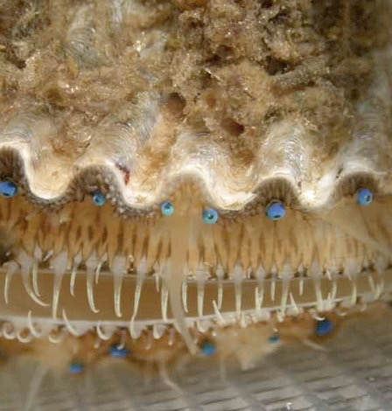
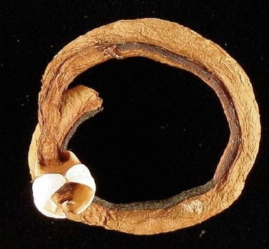
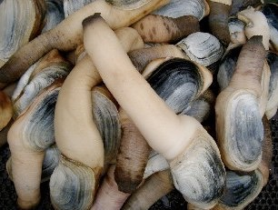
Lamellibranch Diversity
Swimming scallops
http://www.youtube.com/watch?v=tFmMS_a7Q9I
Boring
Symbiosis: bacteria
Shipworms, family Teredinidae
Solemya reidi
Geoducks (genus Panopea)
Notes:
Boring: abrasive edges or acidic mucous; bore as juvenile, “stuck” as adult; shipworm uses reduced shell as drill
Bacteria in shipworms: digest wood in gut
CO2-fixing sulfur bacteria: in gill lamellae; bivalves in sulfide-rich anoxic sediments; bivalve gets nutrition; clam Solemya reidi thrives in industry effluent
Geoducks: enlarged siphon, high fecundity

Slide 69
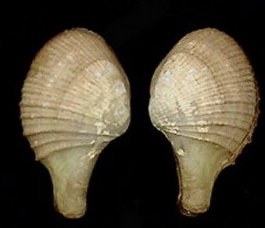
Anomalodesmata
Defining Characteristic
Lacks true teeth or hinge
Widely distributed
Some hermaphroditic
Up to 15 tentacles around siphon
Aragonitic shell, 2-3 layers
The only Order is Pholadomyoida
Notes:
What other differences would you expect between carnivorous and filter-feeding bivalves? Different digestive enzymes, different trophic niches

Slide 70

Anomaldesmata: Septibranchs
Septibranch ctenidium – carnivorous feeding!
Feeds on polychaetes & crustaceans
Lacks filaments
Muscular septum divides mantle cavity
Chitin-lined stomach
No sorting, no crystalline style
Eulamellibranch gill reduced to become muscular septum
Also decrease in palp size
Suck in prey or use sticky tentacles
Notes:
Septum is derived from gill
Septum moves up & down to change pressure in mantle cavity -> protrudes inhalant siphon to get prey

Slide 71


Anomalodesmata Carnivory
Capture prey using suction from mantle cavity
Large, eversible inhalant siphon – retracts quickly to bring prey to mouth
Tentacles have ciliary sense organs – motion detectors?
Modified intestine to digest large food fragments
Evidence of hemoglobin in red amoebocytes
Very novel bivalve adaptation and evolution!

Slide 72
Anomalodesmata Carnivory
Capture prey using suction from mantle cavity
Large, eversible inhalant siphon – retracts quickly to bring prey to mouth
Tentacles have ciliary sense organs – motion detectors?
Modified intestine to digest large food fragments
Evidence of hemoglobin in red amoebocytes
Very novel bivalve adaptation and evolution!

Slide 74
Fishes

